Slide 1
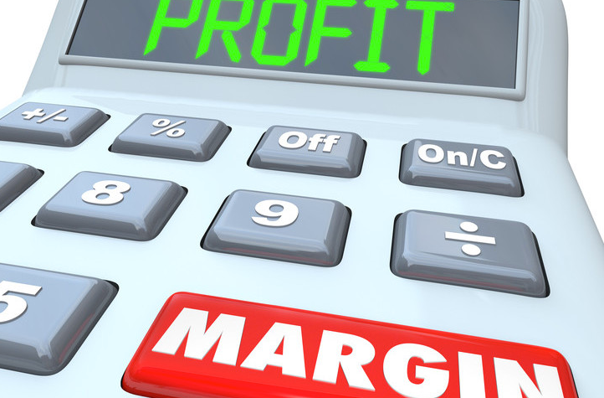
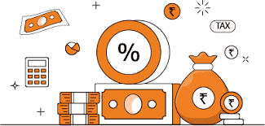
Ratio Analysis
Profitability Ratios

Slide 2
Learning Outcomes
Appraise the efficiency position of the business entities.
Recommend how businesses could improve their efficiency position.

Slide 3

Profitability Ratios
Measures business’s ability to earn profit relative to sales & Investments
How well the business is using its existing assets to generate profits ?

Slide 4
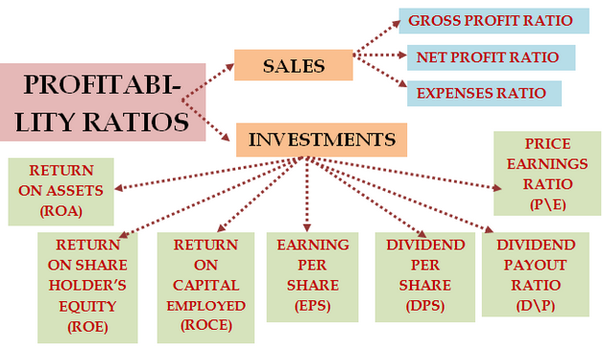

Slide 5
1.) Gross Profit Ratio
Meaning
Measures the relationship b/w gross profit & net sales
Objective
It measures the cost of operations on every Rs. 100 sales
Formula
Net Sales – COGS _{*100}
Net sales

Slide 6
Interpretation
High GP ratio => low cost of production & high sales
Low GP ratio => high cost of production & low selling price

Slide 7
Poll
A company manufactures each widget for $80 and sells it in the market for $120.
In such a case the gross profit ratio of the company will be:
35%
33%
36%
37%

Slide 8
2.) Operating Ratio
Meaning
Measures the relationship b/w operating cost & net sales
Objective
It measures the cost of operations on every Rs. 100 sales
Formula
Operating cost _{*100}
Net sales
Notes:
Operating cost = cost of goods sold + office expenses + administrative expenses + selling expenses + distribution expenses

Slide 9
Interpretation
Indian railways have the operating ratio of 95-110% in past 4-5 financial years.
This is highly unfavourable.
On Sale of Rs. 100
Rs. 95 is consumed as ‘operating expense’

Slide 10
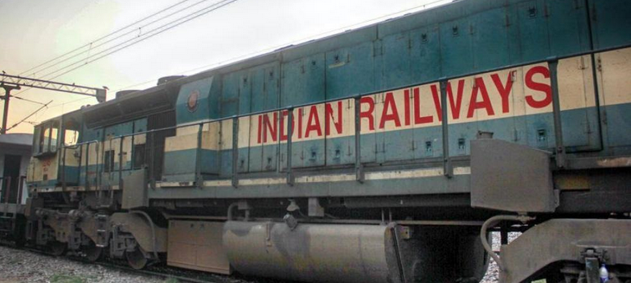
News Analysis
Railways’ operating ratio in FY 20 was at its worst ever
It signifies:
It does not have money for capital investments. Therefore,
laying new railway lines,
deploying more coaches and
similar modernisation efforts cannot be carried out.

Slide 11
Poll
Following are the expenses (in Rs. 000’) incurred by the company in the year 2022,
Advertisement expenses = Rs. 200, Taxes paid = Rs. 100, Administrative expenses = Rs. 200 and interest on loan = Rs. 50.
In lieu of this, the total operating cost of the company will be:
Rs. 500
Rs. 400
Rs. 450
Rs. 550
Notes:
b

Slide 12
3.) Operating Profit Ratio
Meaning
Measures the relationship b/w operating profit & net sales
Objective
To determine the operational efficiency of the firm
Formula
Operating profit _{*100}
Net sales
Notes:
Operating profit = net sales – (cost of goods sold + office expenses + administrative expenses + selling expenses + distribution expenses)

Slide 13
Interpretation
Shows revenues left after all the operating costs have been paid.
Shows operating profit earned on sale of Rs. 100.
For example:- if operating profit ratio of a company is 40%. [On every sale of Rs. 100, 60% = operating expenses and 40% = operating profit].
Higher the ratio, better it is for the firm.

Slide 14
4.) Net profit Ratio
Meaning
Measures the relationship b/w net profit & net sales
Objective
To determine the overall profitability of the firm
Formula
Net profit _{*100}
Net sales
Notes:
Total Revenues = Revenue from operations + Other Income
Total expenses = cost of goods sold + office expenses + administrative expenses + selling expenses + distribution expenses + interest on loans + tax
Net profit = total revenues – total expenses

Slide 15
Interpretation
Ratio indicates the net profit earned on sale of Rs. 100
It measures the overall profitability of the firm
It shows:-
What amount is left to pay dividend to shareholders
Firm’s capacity to withstand adverse economic condition.

Slide 16
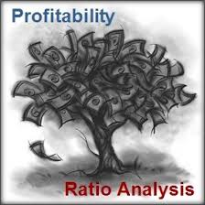
PROFITABILITY RATIOS (OWNER’S VIEW POINT)

Slide 17
Return on Investment (ROI)/Return on Capital Employed
Earnings (before interest and tax) _{*100}
Total funds
Indicates the return that investors could receive on their investment in a company.
Indicates the ‘overall efficiency’ of the firm.
Primary objective of business is to maximise the earnings of its’ investors, this ratio indicates to what extent this primary objective has been achieved.
Higher the ratio, better it is
Notes:
Total funds = Equity share capital+ Reserves and surplus – fictitious assets (or accumulated losses)+ Preference Share Capital+ Debt Funds
Total funds or capital employed

Slide 18


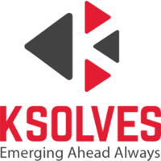
Companies with ‘highest’ ROCE in FY 2021-22
Industry
Services
Industry
IT Software
Industry
Pharma
236%
140%
97%

Slide 19
Poll
A company is having Equity share capital $3000, Reserves $600, Long – term loans $400.
The Earnings after tax are $2900. Tax paid by company is $100
The ROI of the company is:
75%
25%
50%
35%

Slide 20
Return on Equity capital (ROEC)/Shareholder Funds
Also known as ‘Return on Net Worth’.
The profitability & performance of company is judged using this ratio.
Ratio used by equity shareholders.
Formula:
Earnings available to Equity Shareholders_{*100}
Shareholder Funds
Higher ratio is favourable as it means that the company is efficient in generating income on investment.
Notes:
Shareholder Funds = equity share capital + reserves and surplus – accumulated losses

Slide 21
Interpretation
Measures overall efficiency of the business.
Owners are interested in knowing the profitability of the business in relation to their money invested in it.
High ratio will satisfy the shareholders (or owners).
Low ratio indicates low profitability of the company.

Slide 22
Poll
The company is having the PAT of $10,000. It has paid dividend of $4000 to the preference shareholders.
The liability side of the balance sheet contained the equity share capital of $100,000 and reserves of $10000.
In such case ROEC of the company is:
5.45%
13.72%
16.27%
12.72%

Slide 23
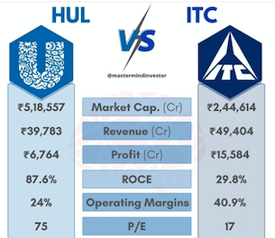
Analysing Profitability in FMCG Sector

Slide 24
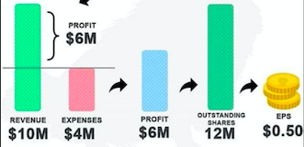
3) Earning Per Share (EPS)
Measures the net income (in rupees) earned by each share
Formula
Earnings available to Equity Shareholders
Number of equity shares outstanding
Higher the ratio, better it is as it means
the company is more profitable and
the company has more profits to distribute to its shareholders.
the company has strong financial position.
it is the reliable company to invest money.

Slide 25
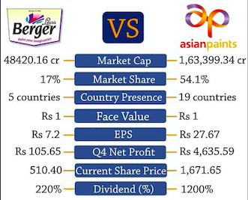
EPS in Paint Industry

Slide 26
Poll
Following information is given about the EPS of JKL Ltd.
It signifies that JKL Ltd is:
Reliable company to invest money
Has weak financial position
Distributing less dividend to its’ shareholders over a period of time
The equity share capital of the company has fallen in last two financial years.
EPS | 2018 | 2019
 | Rs. 150/share | Rs. 345/share
Notes:
d

Slide 27
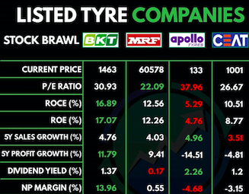
Analysing the Profitability position in Tyre Industry

Slide 28
4) Price earning ratio (P/E ratio)
Relationship b/w stock price and earnings of the company
Shows how much amount an investor is willing to pay to buy 1 share based on its’ earnings.
Formula
Market price per share (MPS)
Earnings per share (EPS)

Slide 29
Interpretation
For example:- if the P/E ratio = 10 times, this means that the market price of the share of the company is 10 times the earnings of the company.
High P/E ratio indicates that the share of the company is sold in the stock market at a high price and the investors have high expectations.
Low P/E ratio indicates low profits of the company as the EPS (denominator) is less.

